Slide 1

CryptoCamp A comprehensive overview of blockchain and cryptocurrencies for beginners
By Ledgerback
Questions or Comments? Message us at hello@ledgerback.coop

Slide 2
DISCLAIMER
The views and opinions expressed herein are solely those of the author, and do not represent in any way shape or form the opinions of another person or organization.
Any material cited in this tutorial has not been verified or authenticaited for accuracy by the author.
Any forward-looking statements concerning any coin or token are merely speculative and no guarantee of future earnings or profits.
By using this tutorial, you explicitly agree that the author(s) is/are not responsible for any and all losses (whether financial or not) including inconceivable (i.e., Act of God) losses that arises from your use of this tutorial.
Any products, organizations, projects or companies (“Organization”) mentioned or referenced in this tutorial are not endorsed by the author(s), nor does any Organization endorse the author(s)’s creation or promotion of this tutorial.
The author(s) is/are not responsible for the safety of external sites linked, or referenced, in this tutorial.
Any use of intellectual property owned by a party who is not the author(s) is/are merely included in this tutorial for normative use.
Any opinion expressed herein is purely and solely the author’s and does not represent the opinion of Ledgerback or any of its other writers.
Please carry out your own research before investing in any of the cryptocurrencies or blockchain proejcts mentioned herein.

Slide 3
ACKNOLWEDGEMENTS
You acknowledge that the information in this tutorial may be inaccurate or out-of-date.
You acknowledge that this kit is solely for informational purposes and should not be construed, or interpreted as, investing, legal, tax, financial, or estate planning advice.
You acknowledge that Ledgerback is not connected with, or endorsed by, any third party individual or organization mentioned or referenced in this tutorial.
You acknowledge that this tutorial does not cover all possible topics in the blockchain and cryptouccrency space.
You acknowledge that CryptoCamp is licensed under the Creative Commons, Attribution-ShareAliek Version 4.0 international license.

Slide 4
Preface
Since the major cryptocurrency bubble in 2017, more and more people are becoming interested in cryptocurrencies and blockchain technology.
However, most people who are interested do not enter the crypocurrencya nd blockchain space. More often than not, people do not take their surface level interest deeper simply because of lack of know-how and the difficulty of finding useful resources.
We believe that this problem will only continue to get worse if we, as members of the blockchain and cryptocurrency space, do not create basic resoruces for interested people to learn and understand this space.
In countering the lack of know-how and apparent unavailability of useful resoruces, we waned to create CryptoCamp, a tutorial that provides a comprehensive overview of the basics in the blockchain and cryptocurrency space.
We hope you find CryptoCamp informative and helpful in your journey to the blockchain and cryptocurrency space.

Slide 5
Materials
1 Private Personal Computer (PC)
1 Smartphone
1 Pencil or Pen
1 Sheet of Paper
1 Valid Credit/Debit Card
Or Bank Account
An Internet Connection
Optional Materials
1 Printer
1 Ledger Nano S

Slide 6
Table of Contents
History………………………………………………………………………………………… 08
Start-Off……………………………………………………………………………………… 20
Blockchain and Cryptocurrency ………………………………………………… 51
Fundraising through Cryptocurrency ………………………………………… 75
Miscellaneous……………………………………………………………………………… 85
References ………………………………………………………………………………… 93

Slide 7
Summary
CryptoCamp covers five major areas that every beginner needs to know to actively participate in the blockchain and cryptocurrency space.
The History section will inform you of some major events that have occurred in the last decade.
The Start-off section will inform you of the necessary know-how on converting US dollars to cryptocurrency, how to sign up on an exchange, and basic cybersecurity measures.
The Blockchain and Cryptocurrency section will inform you of the basic difference between blockchain and cryptocurrency, the underlying technologies of blockchain, what is inside a block on a blockchain, general information about Bitcoin applicable to other cryptocurrencies, and smart-contract platforms such as Ethereum and Neo.
The Fundraising section will inform you of the vaiours methods that individuals, projects and companies use to raise funds or generate income through cryptocurrency.
The Miscellaneous section will inform you of information other than know-how and technical information that will be helpful in understanding the blockchain and cryptocurrency community and nomenclature.

Slide 8
History: Part 0 – Why you should know
The Blockchain and Cryptocurrency field is no different than any other field, history is bound to repeat itself if we do not learn from it.
That is why we start off with the history (a sample of the major events in the space) so that you will:
1) you will have some basic knowledge to help you as you integrate into distributed ledger communities and groups, and
2) hopefully, not suffer the same consequences as those before you.
This guide will tie in historical anecdotes to pertinent parts to help you understand the gravity of properly securing yourself.

Slide 9
History: Part 1—Bitcoin Genesis Block
The Start of it all
The Bitcoin Genesis Block was mined by Satoshi Nakamoto, the creator of Bitcoin, on January 3, 2009, containing the following statement:
“The Times 03/Jan/2009 Chancellor on brink of second bailout for banks.”

Slide 10
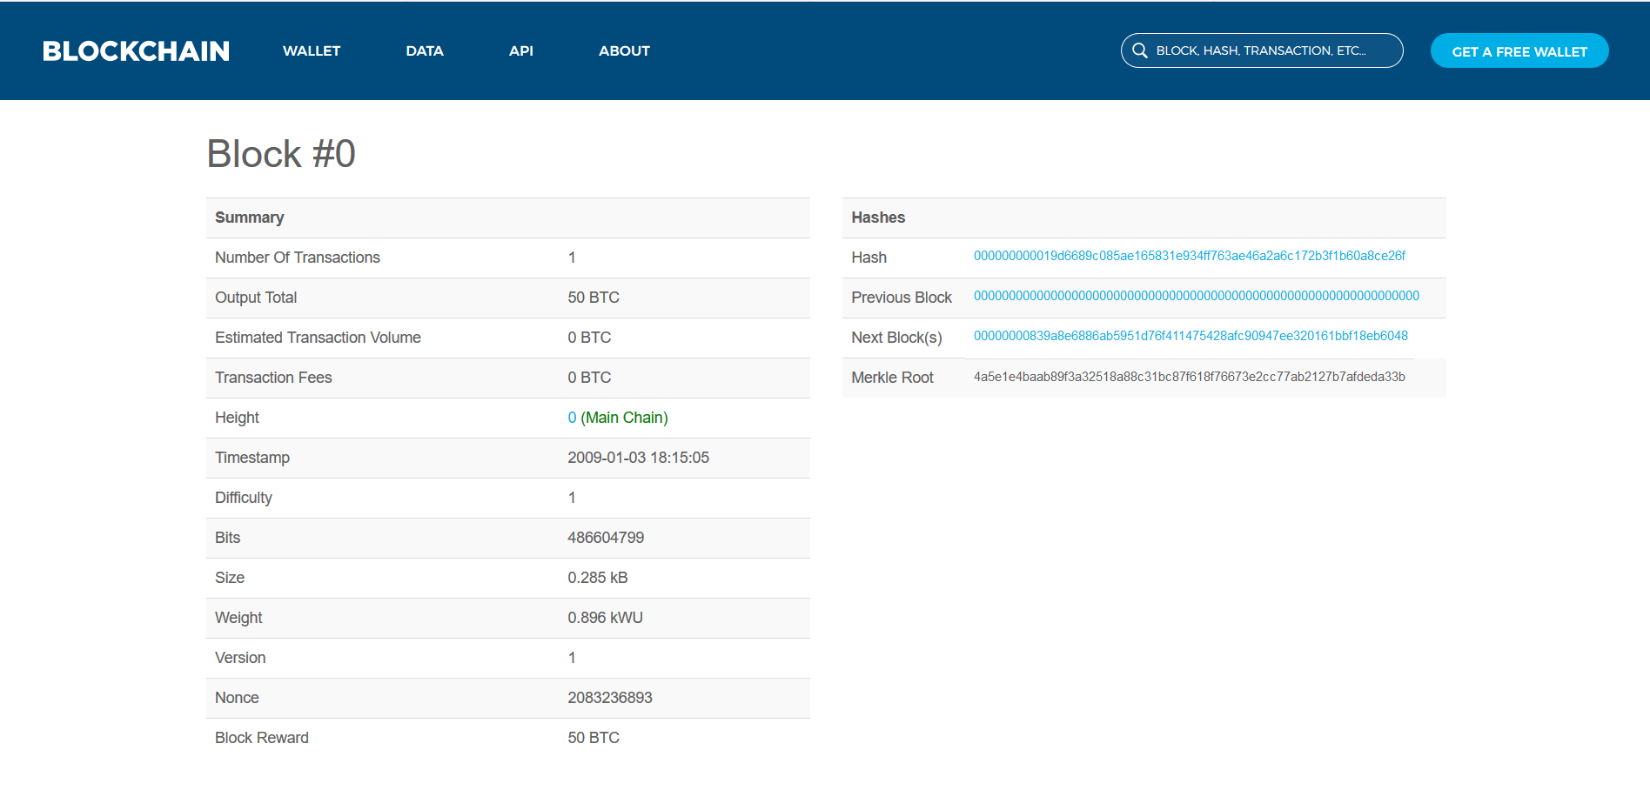
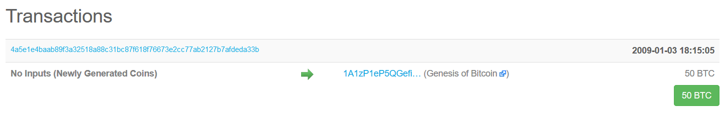
Graphic

Slide 11
History: Part 2 – Who is Satoshi Nakamoto
No one knows who the person or group is that is behind the Satoshi Nakamoto alias.
Satoshi Nakamoto wrote the original Bitcoin whitepaper in 2009, Bitcoin’s original implementation reference, and the first execution of blockchain technology.
Many people have claimed or have been claimed by others to be Satoshi Nakamoto.
For example, Dorian Nakamoto, who shares the same last name as Satoshi Nakamoto, was doxxed by Leah McGrath in March 2014 in a Newsweek article because of his similar last name and circumstantial evidence that he may be Satoshi Nakamoto.

Slide 12
History: Part 3 – Bitcoin Pizza Day
May 22 is Bitcoin Pizza Day, a Cryptocurrency Holiday.
Bitcoin Pizza Day is a Cryptocurrency Holiday because on May 22, 2010, Laszlo Hanyecz bought two Papa John’s pizza’s for 10,000 Bitcoins from a fellow Bitcointalk user, and thus, creating the first real-world transaction with Bitcoin.

Slide 13
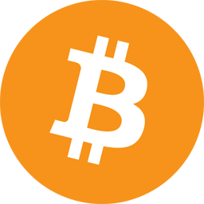

Slide 14
History: Part 4 – Mt. Gox Hack
Mt.Gox was a Japanese Bitcoin exchange that launched in 2010 by Jed McCaleb, and then later bought by Mark Kepeles in 2011, who would lead Mt.Gox to becoming one of the largest bitcoin exchanges in the world.
By 2014, Mt.Gox was one the largest Bitcoin exchanges, accounting for approximately 70-80% of all bitcoin transactions at the time. However, Mt.Gox as an organization had many issues between 2011 and 2014 such as hacks, lawsuits filed by potential partners, investigations by governmental bodies, and an otherwise dysfunctional management.
However, things took a turn for the worse when rumors arose in early 2014 that Mt.Gox’s website had been hacked with 744,400 Bitcoins stolen from the exchange. On February 24, 2014, Mt.Gox ceased operations, shut down its’ website, and no longer allowed customers to withdraw their bitcoin, with a report coming out that same week confirming that 744,400 bitcoins had been stolen, “as well as an additional 100,000 [B]itcoins” from the exchange itself.
On February 28, 2014, Mt.Gox filed for bankruptcy in Japan and the United States.
Currently, Mt.Gox is still going through bankruptcy proceedings with 200,000 Bitcoins Mt.Gox found in an old wallet.dat file being held in trust for creditors.

Slide 15
History: Part 5 – Initial Coin Offerings (ICO)
ICOs first came about in 2013 and 2014 as crowdfunding initiatives for cryptocurrency projects akin to Kickstarter and Indiegogo where a person would ask for capital from the cryptocurrency community to start their project. ICOs started to get more attention as a crowdfunding measure in late 2015 – early 2017.
The first ICO was in 2013 for Mastercoin (now called Omni), run by Thomas Willet.
Ethereum held an ICO in 2014, raising over $18 million dollars
Augur, one of the first projects built on Ethereum, held an ICO raising over $5 million dollars
ICOs as we know them now really gained popularity in mid-2017 with Brave, Mozilla Co-founder Brendan Eich’s internet browser project, running an ICO for their Basic Attention Tokens (BATs), raising $35 million in 30 seconds.

Slide 16
History—Part 6: Ethereum’s Debut
Ethereum, created by Vitalik Buterin and touted as the world’s decentralized computing platform (i.e., new internet), was the first blockchain project to develop a smart-contract layer built on top of a blockchain.
The biggest change from Bitcoin was the additional functionality, no longer was a blockchain only limited to a currency/transfer of value use-case, it could now do other use-cases. A smart contract by the way can be thought of us as “programs that execute exactly as they are set up to by their creators” or a “digital vending machine.”

Slide 17
History—Part 7: Peercoin Proof-of-Stake Fork
Peercoin was the first Bitcoin fork to implement a new consensus algorithm, Proof-of-Stake, where users/owners would be randomly selected for mining based on the amount and age of coins a user has in their wallet.
This was in contrast to the Proof-of-Work model where miners (not required to own the coin/token) who may or may not be owners, would mine by solving complex mathematical problems, which consume large amounts of energy, and all have to compete against each other for the chance to add a block to the chain.

Slide 18
History— Part 8: DAO Hack
Slock.it, a German company building “smart-locks”, i.e., a decentralized version of Airbnb, ran the Decentralized Autonomous Organization (DAO) ICO in 2016, raising over $150 million dollars by the end of the crowdfunding period and becoming the largest crowdfunded project in history.
However, things took a turn for the worse, as they often do in cryptocurrency projects because of lax security, when a hacker stole about 3.6 million ETH (~ $50 million dollars & 15% of ETH Total Supply) by exploiting a vulnerability in the DAO’s smart-contract (which Slock.it did not properly audit before the ICO), whereby sending the large amount of ETH into a “child DAO,” with all the same rules as the original DAO. This theft was large, but, it did not break any of the rules of the Ethereum blockchain.
This Hack led to Ethereum forking into two chains, Ethereum, where the stolen Ether was returned to investors, and Ethereum Classic, where the stolen ether was not returned to investors

Slide 19
History— Part 9: Bitcoin Price Milestones
By March 2017, 1 Bitcoin (~$1,273.32) became worth more than an ounce of gold (~$1,244)
By May 2017, 1 Bitcoin became worth ~$2,000.00
By December 2017, 1 Bitcoin reached an all-time-high of ~$20,000.00

Slide 20
Start Off: Part 0.0— Now and Later
This section provides a succinct and direct guide to integrating blockchain and cryptocurrencies into your daily life.
If you ever have a question regarding how to interact with blockchain and cryptocurrencies, please refer back to this section.

Slide 21
Start Off: Part 1.0— Wallets
A wallet is where your cryptocurrency is stored, and where you will make transactions from.
A “Private Wallet” is a wallet where the owner has control of or access to the private key, which is the only indicator that an individual has the authority to control cryptocurrency contained in a wallet.
Each wallet is specifically made for holding a specific cryptocurrency
E.g., A bitcoin wallet will only hold Bitcoin while an Ethereum wallet will only hold Ethereum and Ethereum Tokens.
In starting out, you will want to obtain a Private Wallet for all major cryptocurrencies or a multi-asset Private Wallet that stores multiple cryptocurrencies
Recommended Wallets:
Ledger
Trezor
Coinomi
Jaxx
Bread (BRD)
Lobstr
O3Wallet

Slide 22
Start Off: Part 1.1 – Wallets
You are going to need 2 Private Wallets:
Hot Wallet
A “Hot Wallet” is a wallet that is connected to the internet
Cold Wallet
A “Cold Wallet” is a wallet that is not connected to the internet
A Hot Wallet is for making immediate transactions (similar to a Checking Account)
A Cold Wallet is for storing funds for a long term (similar to a Savings Account)
Note: Make sure you have access to your Private Key and do not disclose this to anyone no matter the circumstances.
Note: In the event you lose your device, as long as you have your Private Key, you can always regain access to your funds.
Recommendation(s):
Purchase a Hardware (“Physical”) Wallet for your Cold Wallet
Ledger
Trezor
Create a Paper Wallet
Keep this safe and do not show it to anyone nor forget where you left it

Slide 23
Pertinent Advice: Why you need your own Private Wallet
You should always have a wallet where you have the private key in case or in the vent that you participate in an ICO or airdrop, so that you can receive and control your tokens.
First, if you do not have control over the private key, you cannot access your ICO or airdrop tokens
Second, most exchanges are unregulated so there is always the possibility of negative regulatory action that will restrict or prohibit your access to your exchange account
Third, you always have to worry about a third party wallet/ exchange getting hacked and having your funds siphoned into an unauthorized hacker’s public address.

Slide 24
Start Off: Part 2 – Throwaway Accounts
You will need to create 3 Throwaway Accounts
Throwaway Account means an account created that is not connected to the creator’s personal identifiers or used as a personal account which may or may not contain fake information.
2 Throwaway Emails:
Email Providers:
Google
Protonmail
1 Throwaway Number:
Using your Google Mail to create a Google Voice Number
Google Voice
Add 2 Factor Authorization (2FA) to your accounts
2FA Apps:
Google Authenticator
Authy

Slide 25
Pertinent Advice: Hackers stealing personal information from an exchange
In Summer 2017, Bithumb, a Korean cryptocurrency exchange, was hacked by hackers who made off with hundreds of missions of South Korean Won.
This hack was a phishing attack through the personal computer of an exchange employee.
Other than the funds lost, the hackers also stole 30,000 client’s personal information, such as names, email address, and phone numbers.
This is why you use throwaway accounts, to prevent hackers who hack your exchange account from obtaining personal information.

Slide 26
Start Off: Part 3.0— Trading Accounts
Once you have acquired your 2 Private Wallets & created your throwaway accounts, you can set up your trading accounts with an exchange
Possible exchanges:
Binance
Kucoin
Poloniex
Bittrex
Huobi
Bitforex
Kraken
Setting up a Trading Account with your Throwaway Account(s)
First, go to the exchange’s website
Second, click on the sign up button
Third, complete the sign up procedure with your Throwaway Account(s)
Fourth, after you have successfully signed up, add 2 Factor Authorization (2FA) to your account through your Profile
2FA Apps
Google Authenticator
Authy

Slide 27
Start Off: Part 3.1— Trading Accounts
After completing trades on your Trading Account, promptly send your funds back to either your Cold Wallet or Hot Wallet
It is generally a bad idea to leave your funds on an exchange because:
The exchange may prohibit withdrawals in the future
The exchange may implement KYC procedures
The exchange may become insolvent
The exchange may delist a cryptocurrency
The exchange may no longer allow access from your region

Slide 28
Pertinent Advice: Part 4 – BitGrail Hack, i.e., do not leave your funds on an exchange
Around February 9 – 12, BitGrail, an Italian exchange, was hacked for 17 million Nano (XRB) (~ $170 million at the time), and eventually led BitGrail to insolvency.
Unfortunately, this event led to reddit user u/Breakline7 to lose 147,000 Nano (~$1.4 million at the time). Breakline7 held his funds on BitGrail and tried to withdraw his funds as fast as possible but was limited by BitGrail’s 10 BTC per day withdrawal limit, which eventually turned into 1 BTC.
Further, Breakline7’s support tickets were no longer answered and when the hack was announced, Breakline7 realized that all his funds were gone from that point forward.
Hopefully, this cautionary tale cements in you the importance of withdrawing or not leaving your funds on an exchange for a long period of time.

Slide 29
Start Off: Part 4 – Trading
CryptoCamp will not discuss trading know-how, but will provide the following resources:
Autonio Trading Guide
Trading View

Slide 30
Start Off: Part 5.0 – Transactions
Making a cryptocurrency transaction is very simple
Sample Transaction
Sender (person sending Cryptocurrency) will either write down or scan the QR code of the receiver’s (person receiving Cryptocurrency) Cryptocurrency address
Preferably QR code
Sender will choose the amount of Cryptocurrency to send
Sender will send the amount and confirm the transaction
Viewing your Transactions
To view your transaction, you need to find a Block Explorer
Block Explorer means an analytical tool created to examine transactions made on a blockchain.
Refer to the Block Explorer of the cryptocurrency that was sent to the receiver
E.g., if Sender sent Bitcoin, Sender should refer to a Bitcoin Block Explorer, such as https://www.blockchain.com/explorer
Your transaction will be recorded in your Private Wallet but if it is not, refer to the Block Explorer to see if the transaction went through.

Slide 31
Start Off: Part 5.1—Block Explorer
Generally, every cryptocurrency should have a block explorer.
A block explorer is an analytical tool to examine blockchain data
Step-by-Step Guide to using a Bitcoin Block Explorer
Step 1: Enter https://www.blockchain.com/explorer in your address bar.
Skip Steps 2-4 if you do not have a Bitcoin address
Step 2: If you have a Bitcoin address, enter it in the search query
Step 3: Examine your Bitcoin address’s transaction history
Step 4: Return to Step 1
Step 5: Examine:
https://www.blockchain.com/btc/block/000000000000000000274963dec32e2729f2216f565848a21873ca7a698c2490
Step 6: Review the block summary:
You are unlikely to need to know this part in detail but it is good to take a look.
Step 7: Examine the first transaction in the block, this is the newly generated Bitcoins awarded to the miner for adding a new block to the chain, better known as the “Coinbase.”
Step 8: Click on any transaction after the first transaction to see how “transparent” and “public” the bitcoin blockchain is

Slide 32
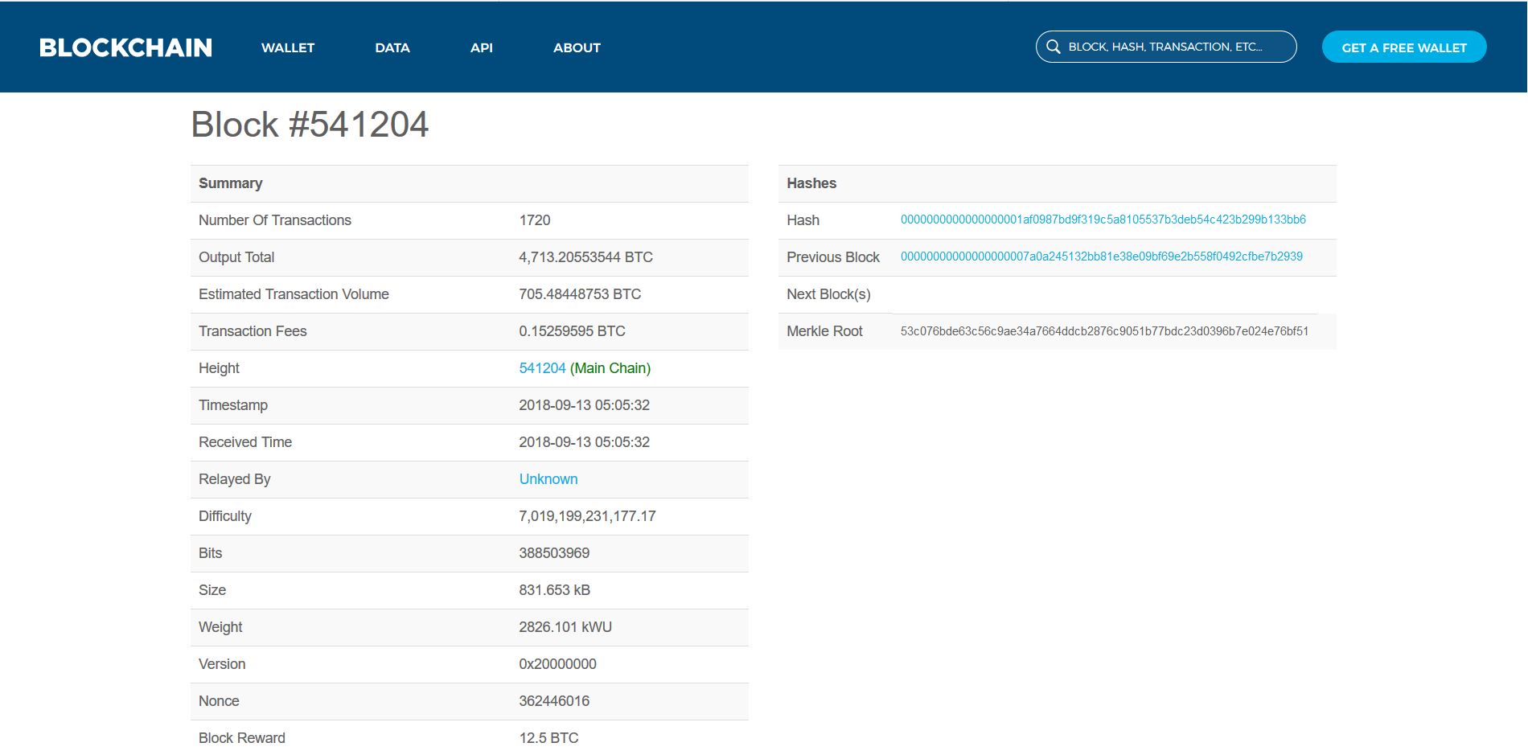
Block #541204 Summary

Slide 33
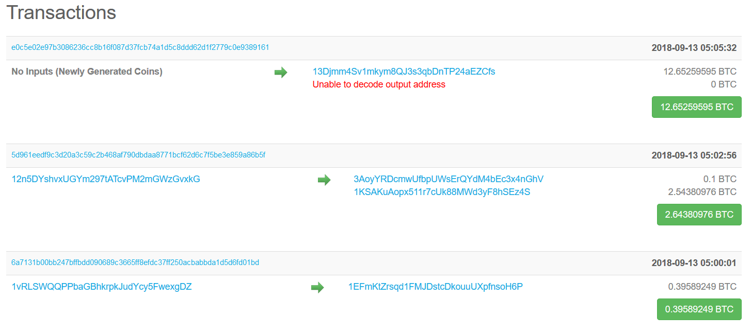
Block #541204 First 3 Transactions

Slide 34
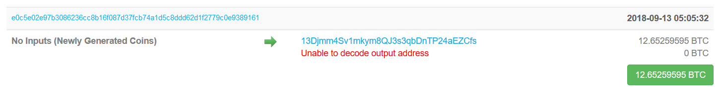
Coinbase

Slide 35
Coinbase— Description
In the earlier slide, the highlighted transaction is called the “Coinbase.”
Coinbase is the block reward given to miners for successfully adding a new block to the Bitcoin blockchain.
Currently, the block reward is 12.5 Bitcoins
The Coinbase is always the first transaction in any Bitcoin block.

Slide 36
Start Off: Part 5.2—What’s in the Block?!
Block Header
Metadata
Previous Block Hash
Valid Hash
Timestamp
Nonce
Solution to the Proof-of-Work (PoW) problem broadcast to the network
There can be multiple solutions to the PoW problem
Difficulty
How hard it is to add a new block to the Blockchain
Constantly readjusted to keep new block additions to 10 minutes.
Merkle tree root Hash
Structure containing transactions
Version Number
Magic Number
0xD9B4BEF9
Block size
Number of bytes contained in the block
Transaction Counter
Transactions

Slide 37
Start-Off Part 5.3 – Multiple Blocks?
Since miners can find different valid solution to the PoW problem, it is possible for a temporary split in the Bitcoin Blockchain to occur.
These splits lead to multiple branches of the Bitcoin Blockchain existing at the same time and leads to the creation of Stale blocks.
Stale Blocks (sometimes correctly or incorrectly called Orphan Blocks) are validly mined blocks which are not part of the main blockchain and any Coinbase from an orphan block is non-spendable. Stale Blocks are blocks which are not part of the main chain (“the longest valid Bitcoin Blockchain”) and have a parent block, while Orphan Blocks are blocks which are not part of the main blockchain and do not have a parent block.
These splits are generally resolved by the “longest chain” rule.
The longest chain rule generally resolves these disputes by presuming that the correct chain is the chain with the most work done or the most combined difficulty, not the chain with the most blocks.

Slide 38
Pertinent Advice: Ethereum Gas
The ability to examine your transactions on a Block Explorer is extremely important to know whether and why your transaction was unsuccessful
For example, on the Ethereum blockchain, users are required to pay a certain amount of Gas (basically, fuel to run operations on the Ethereum blockchain), which is ether, to be accompanied with every transaction on the Ethereum Blockchain.
A transaction may fail on the Ethereum Network if a transaction runs out of Gas, i.e., not enough Gas was provided to run the operations in the transaction even though an appropriate Gas price was provided.
Alternatively, a transaction may fail simply because of a low transaction fee attached. At the worst, you may have sent your Ether to the wrong address or to a non-Ethereum address.

Slide 39
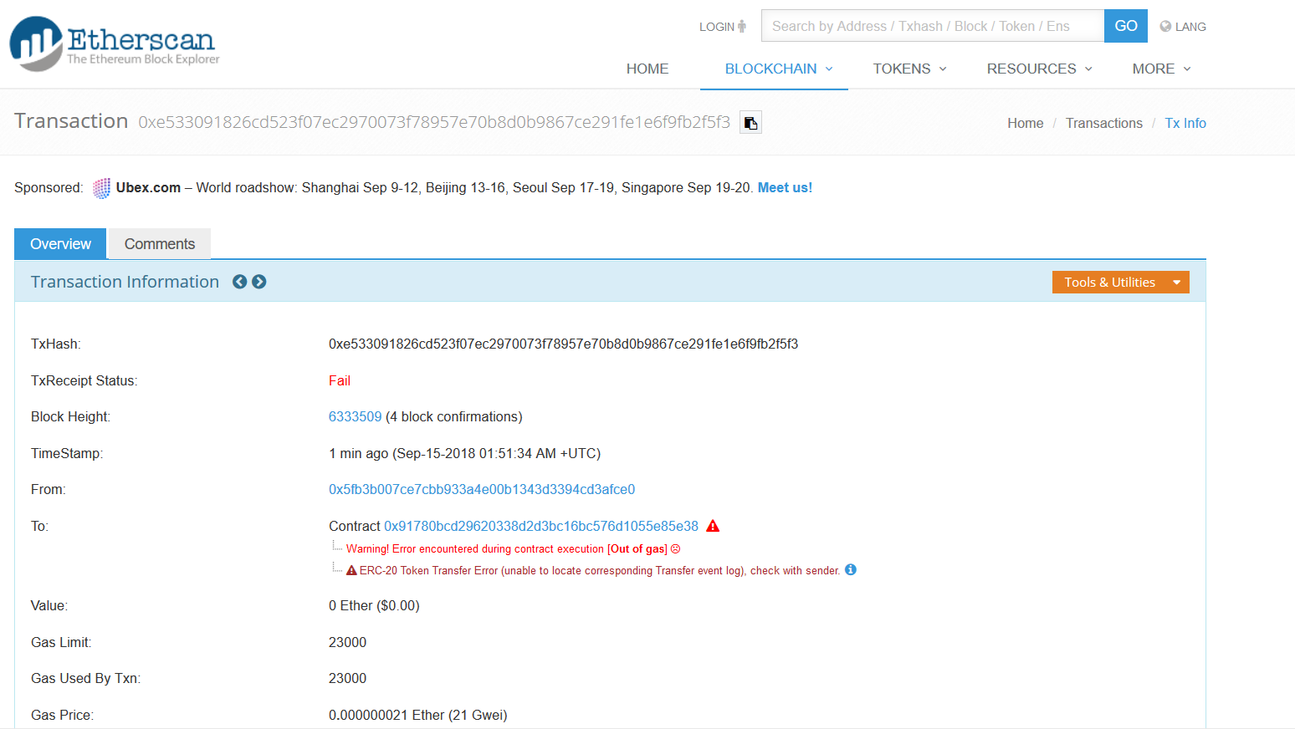

Slide 40
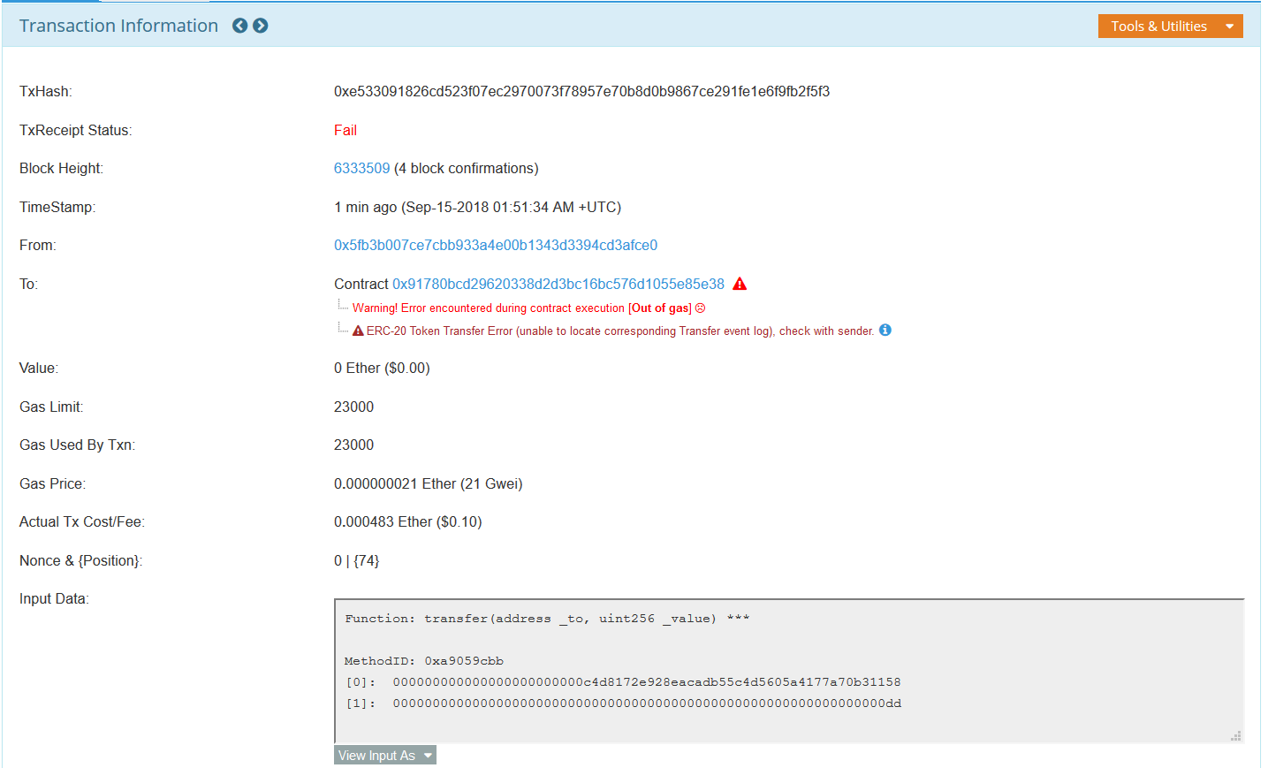

Slide 41
Start Off: Part 6 – Acquiring Cryptocurrency
Acquiring Cryptocurrency can be a hurdle at times but can reasonably be accomplished You use a reliable source.
For example, if you want to turn your USD or EUR into Cryptocurrency (primarily Bitcoin and Ethereum), you should try the following services:
Coinbase
Gemini
Kraken
Circle Invest
Bread Wallet
Changelly
Coincloud ATM
Purse
Paxful
Change
Follow the Service’s sign up procedure to convert your USD or EUR into Cryptocurrency

Slide 42
Start Off: Part 7.0 – Security Measures
These security measures are meant to protect you in your disturbed ledger activities and to hopefully avoid the pitfalls and negative outcomes that have befallen those before you in the History and Pertinent Advice sections.
When you are engaging in Cryptocurrency activities, You should use the following:
A Virtual Private Network (VPN)
A Free one can be acquired by downloading the Opera Browser
2FA

Slide 43
Start Off: Part 7.1 – Security Measures
When engaging in any DLT activities, You should be mindful of these 12 guidelines:
Do not reveal any personal identifying information and your Private Key
Do not brag or attempt to make others aware that you have Cryptocurrency unless absolutely necessary
Do not ever respond to a request on social media or email for Cryptocurrency or an amount of Cryptocurrency in exchange for a smaller amount of Cryptocurrency
This is why you have an exchange account
Review all projects, people and proposals before sending funds to an ICO or other venture
If you acquire a Hardware wallet, use it.
Always ensure you are interacting with the correct Cryptocurrency and do not send a specific Cryptocurrency to a different Cryptocurrency receiving address
The Funds will be lost forever and there is no way to recover them, as of this publication.
Bookmark all official sites you are using or plan to use.
Assume that your Counterparty is out to steal your funds through deceit and fraud
Counterparty means the opposing party in a transaction.
Always use an Ad-blocker and do not ever click on an advertisement
Always use duckduckgo or another privacy-centric search engine for your search queries
Do not save passwords for any cryptocurrency related sites on your device
Write these down on a physical paper for safekeeping or mentally remember them
Write down your Private Keys on a physical piece of paper just in case you ever lose your device and need to regain access to your wallet

Slide 44
Start Off: Part 8— Avoiding Scams
You can avoid scams by doing the following:
Conducting Due Diligence on any interested ICO or Cryptocurrency
Due Diligence means conducting a thorough review of a person(s) or entity(ies) before deciding to participate in their business dealings
Try ConcourseQ for ICO due diligence
Do not interact with others on social media about Cryptocurrency without reviewing their history
Check the alleged receiving address’s history on a Cryptocurrency Block Explorer

Slide 45
Pertinent Advice: Ether Twitter Scam
A commonly found scam on Twitter involves a Twitter user, generally an individual impersonating a more famous individual such as Elon Musk or Vitalik Buterin, offering to all comers or giving away a large amount of Ether (e.g., 5,000 ETH) to anyone who wants to participate in exchange for a certain amount (generally small) of Ether.
The pattern is as follows:
You send the scammer a small amount of Ether and in return
They will send you a large amount of Ether.
Avoid this scam as much as possible and remember the golden rule, “if it sounds too good to be true, it is.”

Slide 46
Start Off: Part 9 – Finality
All Cryptocurrency transactions are final. They cannot be reversed nor can new Cryptocurrency be created specifically to redress your loss of funds.
Once funds are sent to a receiver, the funds are forever theirs and there is nothing you can do to recover your funds other than asking the receiver to return your funds back to your address.
Do not send a specific Cryptocurrency to a different Cryptocurrency’s Address (e.g., A sender sending Bitcoin to a receiver’s Ethereum address)
This Cryptocurrency will be lost forever and cannot be recovered.

Slide 47
Start Off: Part 10.0— Market Aggregators, News outlets, Educational sources
Market Aggregators:
CoinMarketCap
Livecoinwatch
Bitgur
CoinGecko
Coin360
CryptoCompare
Coincodex
News Sources:
Coindesk
CoinTelegraph
Cryptovest
CCN
TrustNodes
InvestinBlockchain
Blockonomi
ETHnews
CoinCenter
CryptoBriefing
Coinannouncer
Nulltx
Cryptoslate
Unhashed
Educational Sources:
Coinyou
Binance Academy
Bitdegree

Slide 48
Start Off: Part 10.1— Market Information, Project Information, Social Media
Social Media:
Bitcointalk
Minds
Steemit
Telegram
Twitter
Reddit
r/cryptocurrency
r/cryptotechnology
r/blockchain
Discord
Dev.to
Blockchain Statistics/Analytics
Bitinfocharts
Project Statistics/Analytics
Cryptocompare
Decentralized Apps (dApps) statistics
State of the dApps
https://www.stateofthedapps.com/
Dappradar
https://dappradar.com/

Slide 49
Start Off: Part 10.2— Podcast, Software Development, Job Boards and Merchant Map
Podcast
The Coin Offering
Jimmy Song
The Bitcoin Podcast
Software Development
CoinCodeCap
Job Boards
CoinDesk
CoinTelegraph
The Digital Currency Group
CoinMonks
Project Websites
Merchant Map
Coinmap

Slide 50
Start Off: Part 10.2— Wallets, Digital Asset Trackers, Industry Profiles, Investment Funds
Wallet Providers
Eidoo
O3 Wallet
Coinomi
Ledger
Trezor
Blockchain
Bread
Jaxx
Cryptonator
Digital Asset Trackers
Blockfolio
Cryptonaut
Industry Profiles
Blockchain Bios
Leader Series on Medium
Investment Funds
Grayscale
Pantera Capital

Slide 51
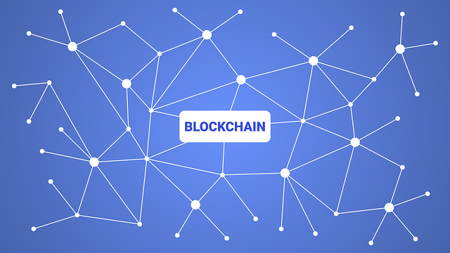
./Blockchain/Cryptocurrency
The slides hereafter will discuss blockchain and cryptocurrency,with a focus on covering technical developments in blockchain technology and Bitcoin.
The paritucalrs of Bitcoin are mostly applicable to all other blockchain and cryptocurrency proejcts and serves as a good starting point for understanding other projects.

Slide 52
Difference between Cryptocurrency and Blockchain
A Cryptocurrency is a native digital bearer asset created, stored, and recorded on a blockchain that may operate as a method of payment, processing fee, and even more.
A Blockchain is an immutable and irreversible digital public ledger which allows a distributed network of computers to verify the authenticity of transactions without the need for a central authority. Additionally, a blockchain is a type of distributed ledger technology, with many others existing such as directed acyclic graph (DAG).

Slide 53
Blockchain Advantage
Advantages over traditional databases:
Relieves a central point of failure
Eliminates need for trusted intermediaries for two counterparties to interact

Slide 54
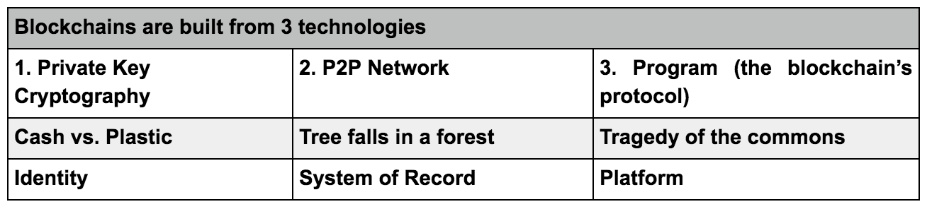
DLT Components: Part 1— Foundational Technologies
3 Technologies that make Distributed Ledger Technology viable:

Slide 55
DLT Components: Part 2.0— Specific Technologies
Blockchain == containers of data that are added together to form a chain.
Block
Data stored in a container
Hashing
A hash function is used to ensure the data integrity and validity of a block.
A hashing function takes some data as an input and outputs a unique, encrypted number
For example, you could use SHA256 to hash some data
In particular to blockchain, the hash of the previous block is required in the hashing function to obtain the hash of a new block. Thus, all new blocks created must rely on the hash of the previous blocks. This ensures data integrity of the chain as a whole because if someone tried to alter a block’s data, that would change the hash and require all sequential blocks’ hashes to be recalculated
Proof-of-Work Consensus Algorithm
Proof-of-Work (POW) is used to control the addition of new blocks to the blockchain, specifically, it addresses the difficulty of adding a new block to the blockchain, while providing consensus on what is or is not the authoritative ledger.
Proof:
Adding a new block means you have performed the requisite work (provided the requisite computing power to solve the computational task)
Work:
Completing the requisite task or “a certain amount of work”/ Solving the computational problem

Slide 56
DLT Components: Part 2.1— Specific Technologies
Adding a Block, aka Mining
This job is generally done by “miners”
In Bitcoin and Ethereum, when a new block needs to be added, the network will send out a computational problem (“Work”) for the miners to solve and whoever solves the computational problem first gets to add a new block to the chain and is rewarded with new coins (“Coinbase”)
When the block is mined, this new block is sent to all the nodes on the network so that every node has the latest version of the blockchain.
This provides an authoritative ledger because the longest blockchain, i.e., the one with the most work done, can be presumed to be the most correct ledger
Starting a Blockchain/ Genesis Block
Every blockchain requires a Genesis Block, i.e., Block 0, from where to start,
The Genesis Block will not contain any hashes of a previous block or value for proof and may or may not contain any usable data.
Difficulty
Blockchains like Bitcoin implement a “difficulty,” to maintain the additional of new blocks at a steady pace (10 minutes for Bitcoin)
Difficulty is a readjustment of the necessary proof for a consensus algorithm, here being POW, because the amount of time to undergo a PoW increases with more blocks and “to account for increasing computational speed and varying numbers of miners on the network”
The harder the computational problem, the more computational power is required to solve it

Slide 57
DLT Component: Part 3— Protocols
A protocol describes how the specific program built on top of the blockchain will work (“software that governs rules, operations, and communication between network nodes”), very similar in effect to the Hypertext Transfer Protocol (HTTP) and Internet Protocol (IP) that the internet runs on.

Slide 58
Other DLT: Part 1— Introduction
Though we are diving a bit deep here, we wanted to let you know about other DLTs.
The DLT space is wide open for innovation and new DLTs will continue to be developed as the space grows larger and larger.

Slide 59
Other DLT: Part 1— Blockchain + Sidechain
A Sidechain is an additional blockchain that interreacts with the main chain, the original blockchain.
Principally, a sidechain allows tokens from one blockchain to be used within a separate blockchain and moved back to the main chain if necessary.
Principally, a sidechain allows the movement of the native digital bearer asset or token from the mainchain to the sidechain and vice versa.
Sidechains are meant to provide increased functionality to a main chain.

Slide 60
Other DLT: Part 2— Directed Acyclic Graph (DAG)
You will also likely hear about Directed Acyclic Graphs (DAGs), another DLT projects like IOTA and Byteball Bytes run on.
Simply, a DAG is a graph that is directed and without cycles connecting the other edges (i.e., the edges only go in one direction).
Basically, it grows in one direction (for our purposes, lets say forward), and will not go backwards to refer to a previous block.
Basically, there is no cycle
Think of a line moving in one direction compared with a circle
Basically, you cannot go to the same block or transaction twice.

Slide 61
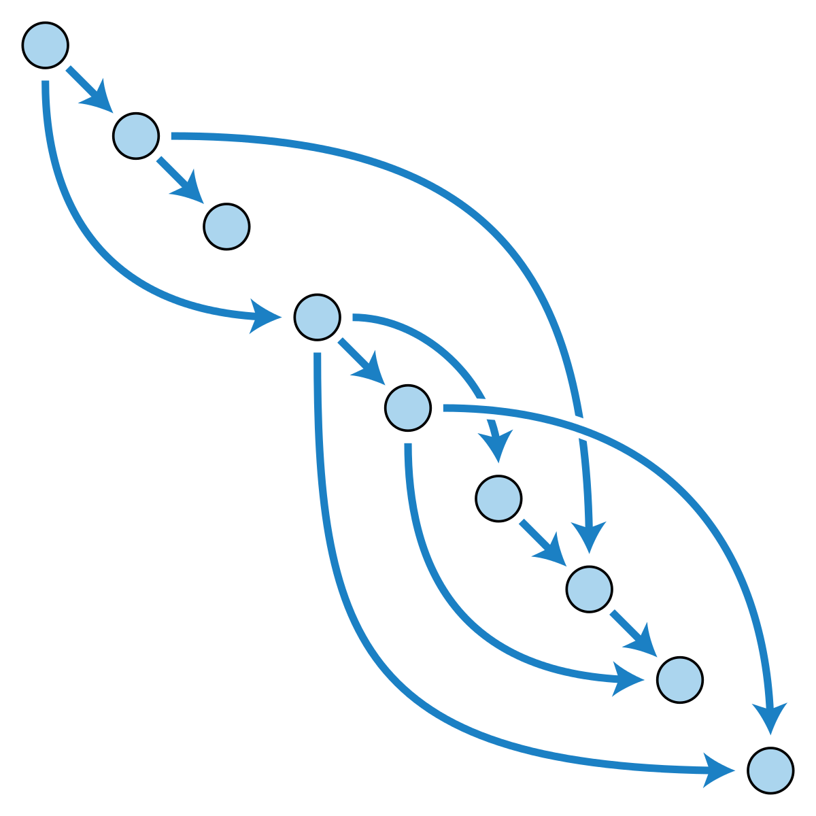
DAG Graphical Example

Slide 62
Bitcoin Particulars: Part 1 – Ecosystem
Users
People who make transactions on the bitcoin network
Miners
People who confirm transactions by adding a new block to the Bitcoin Blockchain
Nodes
Computers running software connected to the Bitcoin Network
Full Node:
A Node that has a copy of the full Bitcoin Blockchain
Wallet Providers
Companies and/or Projects that provide wallet software to store Bitcoin
Exchanges
Where Bitcoin can be traded for other cryptocurrencies or fiat currencies
Developers
Who support on-chain or off-chain development
E.g., Bitcoin Core
Lightning Network

Slide 63
Bitcoin Particulars: Part 2 – Privacy AKA Pseudonymity
Bitcoin’s privacy only extends to providing pseudonymity
Public Addresses on the Bitcoin blockchain do not include any personal identifying information. However, transactions can be still be traced by examining the Intent Protocol (IP) address of the sender and/or receiver
Additionally, Bitcoin is a public blockchain, whereby, anyone can view and analyze all existing transactions through a Block Explorer
Thus, you can still be tracked
For example, researchers at Qatar University and Hamad Bin Khalifa University in Qatar were able to connect an individual's bitcoin transactions to their public accounts on dark-web websites. See also Chainalysis.

Slide 64
Bitcoin Particulars: Part 3—Payment System Efficacy
The two great advantages of Bitcoin as compared to traditional payment systems such as electronic funds transfers, cash, checks, and similar are:
No Fraud
Only authorized persons (those holding the private key) can make transactions
No Double Spending
No user can spend more than they have ownership or authorization over.
Necessity of a Fee
A fee is necessary to compensate miners for their efforts to “mine,” i.e., adding a block to the blockchain, even if they are unsuccessful in their mining efforts

Slide 65
Bitcoin Particulars: Part 4 – Transacting
Bitcoin transactions are generally initiated by a user (“sender”), who sends Bitcoin to another user (“receiver”) identified by their Public Key.
Once the sender has initiated the transaction, the transaction is then broadcasted to the network, whereby miners will take the transaction and include it in a block, and hopefully be the first to add a block to the main chain.
If the miner is successful, the transaction will be completed and recorded on the Bitcoin Blockchain, whereby the receiver can validly say they have received the amount of Bitcoin sent by the sender.

Slide 66
Bitcoin Particulars: Part 5 – Lost Bitcoins
Lost Bitcoins are bitcoins that exist on the Bitcoin blockchain but are inaccessible for a variety of reasons including:
Loss of device containing wallet and no additional copies of Private Key
Private Key was lost
Wallet is no longer accessible because:
Wallet was shut down by the wallet provider
Forgotten password
Wallet data file was corrupted

Slide 67
Bitcoin Particulars: Part 6 – 51% Attack
A 51% attack is when a malicious or non-malicious individual or group obtains >50% control of the network, whereby they can now decide who can add new blocks to the blockchain, and also double-spend any amount of Cryptocurrency (if you have >50% control, by consensus, you have the final say over new blocks)

Slide 68
Beyond Bitcoin: Part 1 – Use-cases
Bitcoin’s particular blockchain implementation is that of a payment system/ financial technology. Though, DLT is not simply limited to Bitcoin’s particular use, but can be applied in a variety of use-cases in multiple industries such as:
Healthcare
Energy
Legal
Supply Chain Management
Funds Management
Credentialing
Art
Internet of Things
Privacy
Cybersecurity
Virtual Reality

Slide 69
Beyond Bitcoin: Part 2— Other Cryptocurrencies
There are many cryptocurrencies created for purposes different than Bitcoin’s and we shall provide a short list of them here:
Privacy coins (focused on enhancing privacy beyond Bitcoin’s privacy level)
Monero
Zcash
Dash
Smart-Contracts (a layer beyond Bitcoin where decentralized applications run as intended by creators without third party interference or censorship)
Ethereum
NEO
Stellar
Waves
Stratis
Ethereum Classic
Internet of Things (devices other than personal computers that are internet-connected)
IOTA
Waltonchain
Blockchain Platforms
Komodo
Zilliqa

Slide 70
Beyond Bitcoin: Part 3— Tokens
Tokens came about after the Bitcoin blockchain was introduced and were hypothesized by Thomas Willet when Willet created Mastercoin (Omni), for tokens on top of the Bitcoin blockchain.
However, it was not until Ethereum came out in 2014 when tokens became part of the initial protocol layer.
Tokens can be thought of as secondary, non-native, digital bearer assets with limited or restricted utility and often require a fee denoted in the native digital bearer asset or fee-designated asset to be transferred.

Slide 71
Beyond Bitcoin: Part 4— Other Consensus Algorithms
There are many consensus algorithms beyond PoW and PoS.
For example, there is also Proof-of-Burn (PoB), wherein coins are burned, i.e., miners send coins to an unspendable address (an address without a private key) on the blockchain.
PoB was created by Lain Stewart to counteract Bitcoin’s environmental impact arising from PoW.

Slide 72
Smart Contracts: Part 1— Ethereum Platform
Ethereum, as discussed earlier, is a smart-contract platform aiming to become the world’s decentralized computer.
Ethereum smart-contracts are written in Solidity, the programming language for Ethereum, and run on Ethereum Virtual Machines (EVMs) that are connected to the Ethereum Blockchain.
A common standard for Smart-Contracts you will encounter is Ethereum Request for Comments 20 (ERC-20), which has become the preeminent standard for Ethereum Tokens.

Slide 73
Smart Contracts: Part 2 – NEO Platform
NEO is a smart-contract platform started in 2014 and based in China.
NEO smart-contracts can be written in any high level programming language such as Python, Java, C#, and are run in a NEO Virtual Machine (NVM)
A common standard for Smart-Contracts you will encounter is Neo Enhancement Protocol 5 (NEP-5), which has become the preeminent standard for NEO Tokens.
Smart contracts can also be considered to be a set of obligations and how those obligations will be fulfilled, defined in a high level programming language, that is stored on a blockchain, and will run as written without any third party interference or censorship

Slide 74
Smart Contracts: Part 3 – dApps
dApps are applications that run on peer-to-peer (P2P) computer networks, and for our purposes, applications that run on a blockchain P2P network.
Blockchain dApps are Web3-enabled websites (websites that interact with blockchains) that use a smart-contract to connect, and take information from, a blockchain, i.e., using the blockchain as a database in the backend.

Slide 75
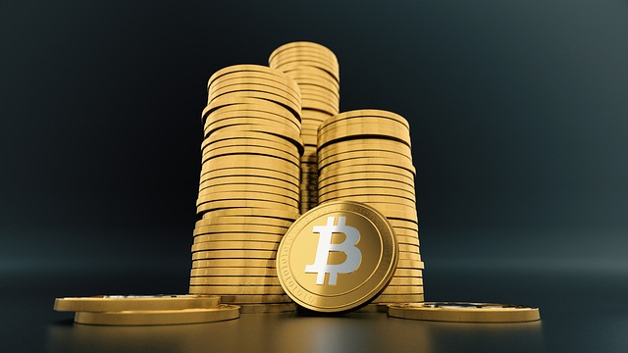
Fundraising through Cryptocurrency
This section covers fundraising methods and models in the blockchain and cryptocurrency space.
This section covers how funds are raised for individuals, projects, and companies in the blockchain and cryptocurrency space.

Slide 76
Initial Coin Offerings: Part 1 – What is an ICO
Initial Coin Offerings (ICOs) are fundraising vehicle for companies, projects, and individuals (“offerors”), where offerors offer cryptocurrency or tokens in exchange for funds from investors in either fiat currency or cryptocurrency to jumpstart their venture before the cryptocurrency or tokens are listed on an Exchange.

Slide 77
Initial Coin Offerings: Part 2 – How to participate in an ICO
First, you need to find an ICO that interests you
Second, you need to find the ICO’s website
Third, you need to follow their procedure for participating in their ICO.
Fourth, if you have any questions about an ICO, refer to the ICO’s support staff or social media channels.

Slide 78
Initial Coin Offerings: Part 3 – How to find information on ICOs
You may use the following as references for ICOs:
ICObench
ICOmarks
TopICOList
TrackICO
ConcourseQ

Slide 79
Airdrops & Bounties: Part 1 – Airdrops
Airdrops Defined
Airdrops are when a project distributes cryptocurrency or tokens to community members without any monetary consideration provided to the project beforehand which may or may not require recipients to fulfill certain conditions before receiving cryptocurrency or tokens.

Slide 80
Airdrops & Bounties: Part 2 – Bounties
Bounties Defined
Bounties are when a project distributes cryptocurrency or tokens to recipients for completing social media or other promotional tasks instead of requiring recipients to provide any monetary consideration before receiving cryptocurrency or tokens.
Bounties are often conducted by projects to raise awareness of their ICOs

Slide 81
Airdrops & Bounties: Part 3 – Information
You can find information concerning Airdrops and Bounties at the following Airdrop aggregators:
Airdrops
Airdropalert

Slide 82
Masternodes
Masternodes are nodes that are required to hold certain amount (generally large) of a specific cryptocurrency before they are delegated with completing certain tasks for the network such as:
Transaction Verification
Network Propagation
Once a node is considered a Masternode, in exchange for completing network tasks, the Masternode will be compensated with cryptocurrency.
For Masternode information, refer to:
2MasterNodes

Slide 83
Mining
Mining, as discussed earlier, is the process of adding a new block to the blockchain through verification of transactions and determining consensus on the one, true chain.
Here are some mining resources to help you if you want to become a miner:
https://whattomine.com/coins
https://motherboard.vice.com/en_us/article/59zdjq/an-idiots-guide-to-building-an-ethereum-mining-rig
https://www.bitcoinmarketjournal.com/bitcoin-mining-rig/
https://cryptosrus.com/ethereum-mining-rig/

Slide 84
Mining- Particulars
Block halvening
When the block reward for adding a new block to the blockchain is cut in half, and will progressively continue till rewards are eliminated. This often occurs on PoW blockchains such as Bitcoin.
Mining Difficulty
Difficulty on a blockchain network describes how hard or difficult it will be for a miner to add a new block to the chain. Difficulty is often adjusted on the Bitcoin blockchain to keep block addition within a ten-minute cycle.
Mining Algorithms
Mining algorithms are generally blockchain-specific (Ethash for Ethereum, Zhash for Zcash), but there are some Cryptocurrencies which may be mined with the same mining algorithm (e.g., CryptoNight)
ASIC
Application-specific integrated circuit (ASIC) is an integrated circuit created for a particular use, and in this context, for cryptocurrency mining.
ASIC Resistance
A Cryptocurrency that is specifically made, or intentionally implements controls, to avoid the growth of ASICs in the mining ecosystem.
Mining Rigs
A mining rig is a dedicated system (generally made of many high-quality GPUs) for mining Cryptocurrency.
Mining Rigs and Factories
Mining factories are large warehouses full of mining rigs. More often than not, the largest mining factories are in China (Esp. for Bitcoin)

Slide 85
Miscellaneous
This section covers miscellaneous information that will be helpful in understanding the blockchain and cryptocurrency space.

Slide 86
Major Companies with a blockchain service or platform
International Business Machines (IBM) Hyperledger
https://www.hyperledger.org/
Microsoft Azure’s Ethereum as a Service
https://azure.microsoft.com/en-us/blog/ethereum-blockchain-as-a-service-now-on-azure/
Amazon Web Services Blockchain Templates
https://aws.amazon.com/blockchain/templates/
Facebook Blockchain Division
https://www.theverge.com/2018/5/8/17332894/facebook-blockchain-group-employee-reshuffle-restructure-david-marcus-kevin-weil
Goldman Sachs-backed start-up Circle
https://www.cnbc.com/2018/05/15/goldman-sachs-backed-start-up-circle-introducing-a-crypto-us-dollar.html
Intercontinental exchange-backed Bakkt
https://blockonomi.com/what-is-bakkt/

Slide 87
Cryptocurrency Cemetery
Here is a list of dead cryptocurrencies/projects and the reason’s for their death:
Coinopsy
Deadcoins
This is possible for any project so always keep that in mind.

Slide 88
Whitepaper
Whitepapers are documents proposing why a certain application or process provides a better solution compared to other methods in solving a particular problem.
Whitepapers are the commonplace (but are slowly losing prominence in the ecosystem) starting point for most blockchain projects.
However, always be on the lookout for plagiarized or false whitepapers.

Slide 89
Use-case Projects Shortlist 1
Videogames
Enjin
Gamecredits
Energy
Brooklyn Microgrid
Power Ledger
Healthcare
Patientory
Forecasting
Augur
Gnosis
Gaming
FunFair
File storage
Sia
Storj
Filecoin
Cybersecurity
Rivetz
Financial Services
Salt
Nexo
Stellar

Slide 90
Use-case Projects Shortlist 2
Real Estate
RealX
Atlant
Logistics
ShipChain
Trace
Virtual Private Network
WinQ
VPNcoin
Video sharing
LBRY
Music
Ujo
SingularDTV
Decentralized Internet
Maidsafe
Skycoin
Exchange-traded tokens
Bibox token
Binance coin
Kucoin Shares
Search Engine
Nebulas
Presearch
Payment System
Bitcoin Cash
Litecoin
Digibyte
OmiseGo
0x
Blockchain Platform
Komodo
Zilliqa
Voting
Horizon State

Slide 91
Suggested dApps & crypto-related apps to test out
Brave Browser
Status messenger
Purse.io
Steemit
Minds
Lbry
Ujo
Presearch
Musicoin
See StateoftheDApps or DappRadar for more dApps

Slide 92
Shortlist of Terminology
FUD
FUD is an acronym for Fear, Uncertainty, and Doubt.
Hodl
Hodl means keeping cryptocurrency stored in a person’s wallet regardless of any negativity. Further, it can also be considered an acronym for “Hold On for Dear Life.”
P2P
P2P means peer-to-peer.
Atomic swaps
Atomic swaps means the exchange of cryptocurrencies or any data from one blockchain to another blockchain.
Satoshis
Satoshis mean a monetary unit of the smallest amount of Bitcoin that may be sent. Named after Satoshi Nakamoto.
1 Satoshi = 0.00000001 BTC
Whitepaper
Whitepaper means an informational document describing the benefits of implementing a product, service, or solution.
Hot Wallet
Hot Wallet means any wallet that is connected to the internet.
Cold Wallet
Cold Wallet means any wallet that is not connected to the internet. Cold Wallet is synonymous with the term, “Cold Storage.”
Block explorer
An analytical tool to analyze data stored on a blockchain
Main Chain
The “longest chain” in the Bitcoin Blockchain. Can also refer to the blockchain of the main net.
Main Net
The main network were transactions are recorded on the main chain.
Test Net
The test network were transactions are not recorded on the main chain
2FA
An acronym for 2 Factor Authorization, a security measure that requires two forms of authorization before an account can be accessed.
ICO
An acronym for Initial Coin Offering, which is an unregulated means of crowdfunding by offering participants tokens in exchange for monetary investments.
Coinbase
The block reward given to a miner for successfully adding a block to the blockchain
For more terms, please refer to decryptionary.com

Slide 93
References
The slides hereafter provide the sources we used in creating CryptoCamp.

Slide 94
References: Part 1
Slide 8-9:
https://en.bitcoin.it/wiki/Genesis_block ; https://blockexplorer.com/block/000000000019d6689c085ae165831e934ff763ae46a2a6c172b3f1b60a8ce26f ; https://www.blockchain.com/btc/block/000000000019d6689c085ae165831e934ff763ae46a2a6c172b3f1b60a8ce26f
Slide 10:
https://www.ccn.com/called-the-inventor-of-bitcoin-satoshi-nakamoto/
Slide 11:
https://www.investopedia.com/news/bitcoin-pizza-day-celebrating-20-million-pizza-order/
https://www.coindesk.com/bitcoin-pizza-day-celebrating-pizza-bought-10000-btc/
Slide 13:
https://blockonomi.com/mt-gox-hack/
https://www.coindesk.com/mt-gox-the-history-of-a-failed-bitcoin-exchange/

Slide 95
References: Part 2
Slide 14:
https://www.forbes.com/sites/laurashin/2017/09/21/heres-the-man-who-created-icos-and-this-is-the-new-token-hes-backing/#29ce37f41183
http://allcoinsnews.com/2015/09/16/augur-crowdsale-reaches-4-7m-with-2-weeks-remaining/
http://allcoinsnews.com/2015/09/16/augur-crowdsale-reaches-4-7m-with-2-weeks-remaining/
http://augur.strikingly.com/blog/the-crowdsale-what-s-new-and-what-s-next
https://www.coindesk.com/35-million-30-seconds-token-sale-internet-browser-brave-sells/
Slide 15:
https://cointelegraph.com/news/ethereum-raises-3700-btc-in-first-12-hours-of-ether-presale
https://www.coindesk.com/information/ethereum-smart-contracts-work/
Slide 16:
https://bitfalls.com/2018/03/11/peercoin-explained-proof-stake-pioneer/

Slide 96
References: Part 3
Slide 17:
https://www.coindesk.com/understanding-dao-hack-journalists/
https://www.coindesk.com/understanding-dao-hack-journalists/
https://www.wired.com/2016/06/50-million-hack-just-showed-dao-human/
https://www.coindesk.com/understanding-dao-hack-journalists/
https://www.coindesk.com/understanding-dao-hack-journalists/
https://www.coindesk.com/ethereum-classic-explained-blockchain/
Slide 18:
https://www.marketwatch.com/story/bitcoin-is-now-worth-more-than-an-ounce-of-gold-for-the-first-time-ever-2017-03-02
https://www.forbes.com/sites/laurashin/2017/03/02/1-bitcoin-is-now-worth-more-than-an-ounce-of-gold/#670cca9150f4
https://www.livecoinwatch.com/price/Bitcoin-BTC
https://cointelegraph.com/news/bitcoin-hits-2000-on-bitfinex-as-bullrun-beats-bubble-fears
https://cointelegraph.com/news/bitcoin-hits-20000-per-coin-capping-year-of-enormous-growth

Slide 97
References: Part 4
Slide 19:
What is Cryptocurrency. Guide for Beginners: How to Store, Cointelegraph, https://cointelegraph.com/bitcoin-for-beginners/what-are-cryptocurrencies#history (last visited Aug. 13, 2018) [hereinafter How to Store].
Slide 21:
https://hackernoon.com/why-you-should-never-keep-crypto-tokens-on-an-exchange-wallet-5856fa79026b
Slide 22:
Google
Protonmail
Google Voice
Google Authenticator
Authy

Slide 98
References: Part 5
Slide 23:
https://bitcoinmagazine.com/articles/latest-cryptocurrency-exchange-hack-highlights-need-better-security-protocols/
Slide 24:
Binance
Kucoin
Poloniex
Bittrex
Huobi
Bitforex
Kraken
Google Authenticator
Authy

Slide 99
References: Part 6
Slide 26:
https://techcrunch.com/2018/02/12/bitgrail-hack-nano/
https://www.reddit.com/r/CryptoCurrency/comments/7whndj/i_lost_147k_nano_14_m_and_falling_in_the_bitgrail/
http://fortune.com/2018/02/11/bitgrail-cryptocurrency-claims-hack/
https://hackernoon.com/why-you-should-never-keep-crypto-tokens-on-an-exchange-wallet-5856fa79026b
Slide 27:
Autonio Trading Guide
Trading View
Slide 28:
https://www.blockchain.com/explorer

Slide 100
References: Part 7
Slide 28- 33:
https://www.blockchain.com/explorer
https://www.blockchain.com/btc/block/000000000000000000274963dec32e2729f2216f565848a21873ca7a698c2490
Slide 34:
https://dev.to/damcosset/blockchain-what-is-in-a-block-48jo
https://en.bitcoin.it/wiki/Block
Slide 35:
https://en.bitcoin.it/wiki/Block
https://en.bitcoin.it/wiki/Vocabulary#Main_Chain

Slide 101
References Part 8
Slide 36-38:
https://media.consensys.net/ethereum-gas-fuel-and-fees-3333e17fe1dc
https://ethereum.stackexchange.com/questions/3/what-is-meant-by-the-term-gas
Slide 39:
Coinbase
Gemini
Kraken
Circle Invest
Bread Wallet
Changelly
Coincloud ATM
Purse
Paxful
Change

Slide 102
References: Part 9
Slide 40:
Opera Browser
Slide 41:
Duckduckgo
Slide 43:
https://blockonomi.com/musk-eth-scam/
https://www.coindesk.com/6-outrageous-moments-crypto-twitter-scam-history/
https://medium.com/coinremix/twitter-scam-elon-musk-is-not-giving-you-free-eth-one-tweet-has-collected-155-eth-and-counting-2f52fe35b5a8
Slide 47:
https://www.coindesk.com/information/what-is-ether-ethereum-cryptocurrency/
Mark E. Burge, Apple Pay, Bitcoin, and Consumers: The ABCs of Future Public Payments Law, 7 Hastings L.J. 1493, 1529 (2016).

Slide 103
References: Part 10
Slide 48:
https://www.coindesk.com/information/why-use-a-blockchain/
https://www.coindesk.com/information/what-is-blockchain-technology/
https://www.datacamp.com/community/tutorials/blockchain-r?utm_campaign=News&utm_medium=Community&utm_source=DataCamp.com
Slide 49:
https://www.datacamp.com/community/tutorials/blockchain-r?utm_campaign=News&utm_medium=Community&utm_source=DataCamp.com
https://www.coindesk.com/information/what-is-blockchain-technology/
Slide 50:
https://www.datacamp.com/community/tutorials/blockchain-r?utm_campaign=News&utm_medium=Community&utm_source=DataCamp.com
Slide 51:
https://www.datacamp.com/community/tutorials/blockchain-r?utm_campaign=News&utm_medium=Community&utm_source=DataCamp.com

Slide 104
References: Part 11
Slide 52:
https://hackernoon.com/a-primer-on-blockchains-protocols-and-token-sales-9ebe117b5759
Slide 54:
https://ethereum.stackexchange.com/questions/379/what-is-a-sidechain
https://cointelegraph.com/news/lisk-to-move-developers-from-blockchain-to-sidechain
Slide 55:
https://www.investinblockchain.com/dag-blockchain-new-competitor/
https://www.forbes.com/sites/shermanlee/2018/01/22/explaining-directed-acylic-graph-dag-the-real-blockchain-3-0/#469e3c24180b
https://stackoverflow.com/questions/2283757/can-someone-explain-in-simple-terms-to-me-what-a-directed-acyclic-graph-is

Slide 105
References: Part 12
Slide 56:
https://en.wikipedia.org/wiki/Directed_acyclic_graph#/media/File:Topological_Ordering.svg
Slide 59:
https://www.wired.com/story/bitcoin-drug-deals-silk-road-blockchain/
https://news.bitcoin.com/irs-crackdown-tracking-bitcoiners-with-chainalysis/
Slide 61:
https://en.bitcoin.it/wiki/Block
Slide 67:
http://docs.neo.org/en-us/sc/introduction.html

Slide 106
References: Part 13
Slide 70:
https://coincentral.com/proof-of-burn/
Slide 71:
ICObench
ICOmarks
TopICOList
TrackICO
ConcourseQ
Slide 74:
Airdrops
Airdropalert

Slide 107
References: Part 14
Slide 75:
2MasterNodes
Slide 76:
https://whattomine.com/coins
https://motherboard.vice.com/en_us/article/59zdjq/an-idiots-guide-to-building-an-ethereum-mining-rig
https://www.bitcoinmarketjournal.com/bitcoin-mining-rig/
https://cryptosrus.com/ethereum-mining-rig/

Slide 108
References: Part 15
Slide 77:
https://www.hyperledger.org/
https://azure.microsoft.com/en-us/blog/ethereum-blockchain-as-a-service-now-on-azure/
https://aws.amazon.com/blockchain/templates/
https://www.theverge.com/2018/5/8/17332894/facebook-blockchain-group-employee-reshuffle-restructure-david-marcus-kevin-weil
https://www.cnbc.com/2018/05/15/goldman-sachs-backed-start-up-circle-introducing-a-crypto-us-dollar.html
Slide 78:
https://www.coinopsy.com/dead-coins/
https://deadcoins.com/
Slide 80:
https://www.investopedia.com/terms/w/whitepaper.asp
Slide 81:
Brave Browser
Status messenger

